Slide 1
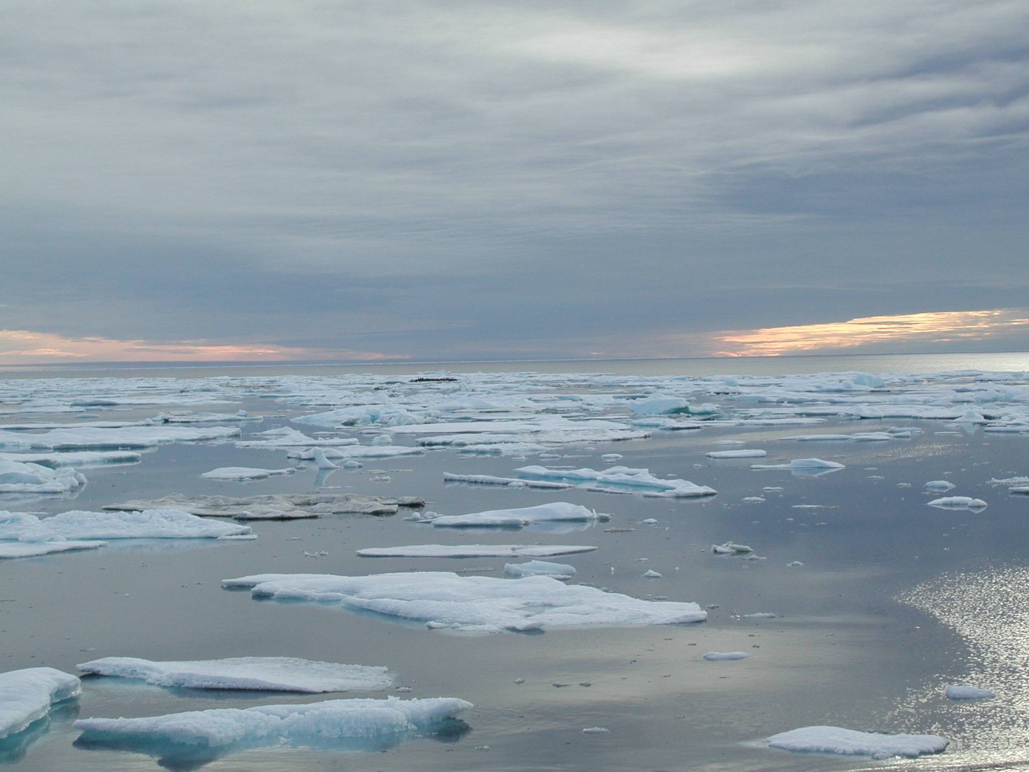
Chukchi Sea Offshore Monitoring in Drilling Area (COMIDA): Chemical and Benthos (CAB)
PIs: Ken Dunton¹, Jacqueline Grebmeier², Lee Cooper², H. Rodger Harvey², John Trefry³, Brenda Konar⁴, and David Maidment¹
¹University of Texas at Austin, ²University of Maryland Center for Environmental Science, ³Florida Institute of Technology, ⁴University of Alaska Fairbanks
Project Objectives:
Conduct open-water season monitoring of anthropogenic chemicals associated with offshore oil and gas exploration in the Chukchi Sea
Distinguish changes in benthic biota in the area of potential or actual offshore drilling areas of the Chukchi Sea
Project Tasks:
Develop a conceptual food web model based on collection of isotopic data
Distinguish changes in benthic biota and anthropogenic chemicals
Monitor sediment chemistry parameters
Provide support for geostatistical modeling of spatial and temporal trends using ArcGIS

Slide 2
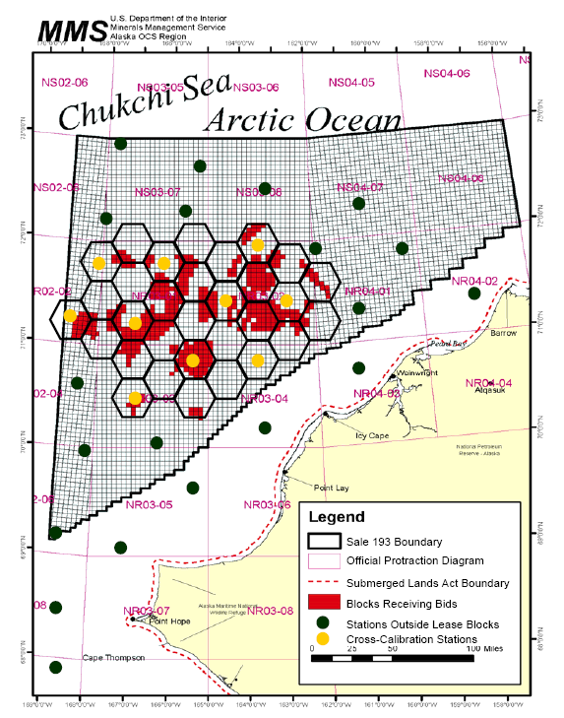
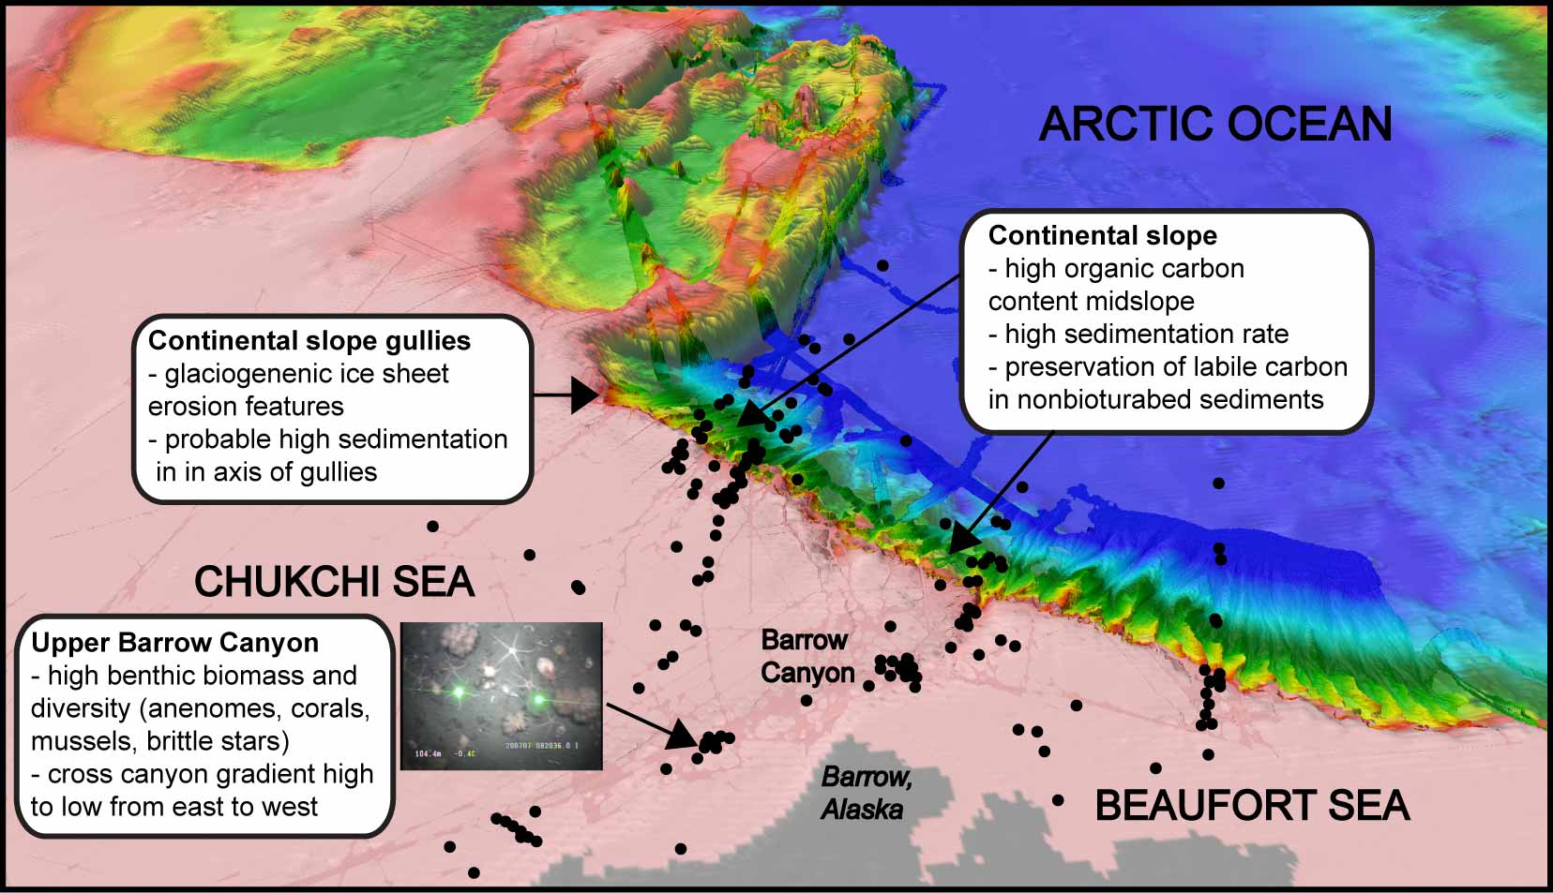
Proposed Sampling Locations: COMIDA
Proposed sampling regime by UT-Austin, 2008
from Dunton et al., 2005
Within and Downstream
of Lease 193 region
from Grebmeier et al., 2008

